Slide 1
Academic Board
Wednesday 22 May 2024

Slide 2
Topics
Academic Board
Highlights from across our community
UK Higher Education
regional context
national and global context
Our University
  People matters
  A reminder of our current and future strategic imperatives
  Update on our four strategies
  Financial headlines
  Looking ahead

Slide 3
Highlights from across our community

Slide 4
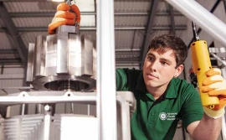
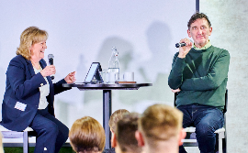

Highlights
Academic Board
HE-BCIS data – success for student start-ups and spin out companies
Philanthropy: over £1 million in donations received towards improving access, student experience and career development, including £60k from the Goyal Foundation to provide scholarships for students from disadvantaged backgrounds.
EDI: Scholarships scheme for Women from Hong Kong for 2024; Disability Confident Level 2 ‘Employer’ status.
Global: Indonesian International Student Mobility Awards success; UK-Ukraine Twinning showcase
Research and Innovation: some exceptional funding successes to report
Alumni: over 1,000 alumni took part NCL in Action ‘Moving on Up’, held in partnership with Newcastle United Foundation celebrating the power of education to transform lives. 900 new alumni attended recent graduation celebrations in Shanghai.

Slide 5
UK Higher Education: regional, national and global context

Slide 6

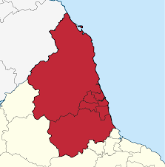





Regional context
Academic Board
Landmark agreement of a Devolution Deal and the formation of a new Mayoral Combined Authority (NECA) for the region, which came into effect on 4 May with an elected Mayor.
Trailblazer deal for North East Mayoral Combined Authority (NECA) announced in the Spring budget including £10m towards a Health Innovation Zone which will support the delivery of our Health Innovation Neighbourhood.
Agreement for five NE universities to formalise collaboration to benefit the region, including widening participation, policy, business support, and joint communications.
Notes:
With every week that passes, the ongoing and devastating consequences of the conflict in the Middle East become more apparent and this is reflected in the impact that we feel within our community. Our priority is to ensure our campus is a safe, inclusive and welcoming environment
The wellbeing and safety of all our students and colleagues is vital.
We are working with the Student Union, Student Societies, faith leaders and colleagues to better understand the impact and how this is changing as the situation develops

Slide 7
Green, inclusive and ambitious
Transport
Economy and investment fund
Skills, education and inclusion
Housing, land and digital
Clean energy and net zero
North East Devolution Deal
Rural economy and sustainability
Culture, tourism and place
Business growth and inward investment
Health and public service reform
Trailblazer and future funding

Slide 8
National and global context
Academic Board
Globally, recognising the current devastating conflicts and ongoing unrest which is causing deep distress for many in our community.
Challenges of HE finances continues with no solution likely in the medium term.
Government rhetoric around international students – with negative impact for HE
  potential changes to the visa route
  outcome of the MAC Review
Political uncertainty
  New Skills, Apprenticeships and HE Minister: Luke Hall
  General election expected within the next 12 months
  US Presidential Election November 2024
Higher Education (Freedom of Speech) Act comes into force in new academic year – difficult balancing act.
Notes:
With every week that passes, the ongoing and devastating consequences of the conflict in the Middle East become more apparent and this is reflected in the impact that we feel within our community. Our priority is to ensure our campus is a safe, inclusive and welcoming environment
The wellbeing and safety of all our students and colleagues is vital.
We are working with the Student Union, Student Societies, faith leaders and colleagues to better understand the impact and how this is changing as the situation develops.

Slide 9
Our University

Slide 10


People matters
Academic Board
Updates to terms and conditions – Grade G and above move to expectation of 37-hour week from 1 May and alignment of annual leave entitlement for grade A-E Colleagues to 30 days planned for next holiday year.
Following feedback, “Essentials” training has been streamlined and a small number of courses made mandatory.
Recent Voluntary Severance scheme closed Friday 22 March; applications currently being reviewed.

Slide 11
Academic Board
Current strategic imperatives
A values-led world-leading university, advancing knowledge, providing creative solutions and solving global problems
ENGAGEMENT & PLACE
Student education experience at the centre of our planning
Inclusive economic growth
Lifelong learning & skills
Policy impact
Research
Power: critical mass + quality
Sustainable research-based education
EDUCATION
for Life
RESEARCH
for Discovery & Impact
Research
Intensivity: funding
Building digital capabilities that enable flexible provision
Research
Culture
Student mobility
Research profile
Sustainable SE Asia Hub
GLOBAL
Culture:
Devolving agency
Enabling values-led behaviours & ambition
Freeing time & stopping things
For 2023-24
- build on progress
- get ready for 2030
Notes:
We’ve been making really good progress in many areas as a University since we launched our Vision & Strategy in 2018. As we emerged from the pandemic in 2021 we took another look at our priorities and identified the most important for each of our cross-cutting strategies as shown in the slide [CLICK]. Each of the faculties has been reporting good progress against these so at the start of this year we agreed not to change them for 2023-24 [CLICK]. We’re asking colleagues to continue to build on the progress they’ve made, for example in student experience, international student recruitment and research income, while we set out sights on the longer term horizon for the University at the end of the decade.

Slide 12
Academic Board
Future strategic imperatives
The decade ahead…
For the 2020s, to deliver our vision and live up to our values, how will we …
Diversify income … and be resilient to (geo)political instability?
Configure our infrastructure … and achieve NetZero?
Give students what they need … and employers what they demand?
Improve productivity and control workloads … to do our best work?
Maintain and draw upon a broad base of disciplines and expertise?
Avoid a pendulum swing between teaching and research?
…?
Our strategy needs us to work together on opportunities to be visibly leading in themes which span education and research, meet demand from students, funders and partners, play to our academic strengths and assets, and anticipate the most important challenges ahead. These themes will guide our choices of investment in people and resources to deliver the University’s mission.
Notes:
In this decade we’re experiencing as much volatility for universities and their students and staff as any of us can remember, and we need to chart a course through these choppy waters, recognising that the Higher Education sector is changing. Big questions include [READ FROM SLIDE]. So, over the last couple of years we’ve been moving away from an annual short term ‘strategic planning’ cycle in favour of 5-year strategic delivery plans that will help us to answer these questions. We’re developing those 5 year plans through a programme called NUShape, or ‘Shaping Newcastle to 2030’.

Slide 13
Research: Consolidating NU Futures and NUAcT
Academic Board
NUCoREs Renewal
Attracting and retaining academic talent from across career stages
Recruiting to targeted, multidisciplinary opportunity areas as aligned with NU Shape
Open to internal candidates where the opportunity is distinctly different from current trajectory
Building a positive research and education culture with opportunity for interdisciplinary collaboration
NUCoREs approaching five-year anniversary invited to renew for future success
No one-size-fits-all: opportunity for NUCoREs to be distinctly different from one another
Collecting and sharing good practice throughout the renewal process
Identifying opportunities for alignment between NUCoREs and other institutional priorities (NU Shape)

Slide 14


Building a positive research culture: Five priority projects
Academic Board
Releasing quality time: increase colleagues’ ability to create protected time for research activities
Behaviour Matters: develop a preventative approach to tackling inappropriate behaviour and promote positive behaviours across the institution
Open Research: develop and deliver an open research training programme to promote openness across the research cycle and make research more transparent
The Research Space: develop an online portal that serves as a one-stop-shop to enable research career development, knowledge sharing and networking
Wellcome Institutional Fund for
Research Culture Project
£1m award to build enhanced leadership capacity to enable psychologically safe and inclusive research environments

Slide 15
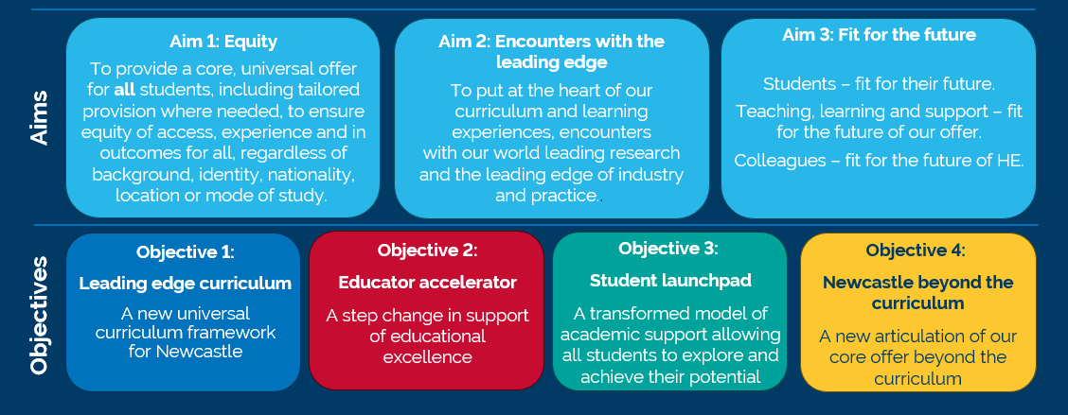
Education (1): Our Education Vision
Academic Board
To be a global, future-facing provider of leading edge, inclusive and transformational higher education for our students.

Slide 16
Education (2): Next Phase = Implementation
Academic Board 2024
Leading Edge Curriculum
Project Lead: Sara Marsham
Student Launchpad
Project Lead: Sarah Graham
Next Steps
Inaugural Education Strategy Programme 2nd May 2024
Confirm project teams, who will:
Undertake horizon scanning to capture ideas and good practice.
Engage with a wide range of stakeholders internally and externally.
Build upon and capture benchmarking and an evidence base for why things need to change.
Ensure regular communication with the wider University.
Provide recommendations for future-state.
Provide project updates to the Education Strategy Programme Board.
ANNOUNCEMENT
An upcoming announcement will invite expressions of interest from individuals who wish to participate

Slide 17

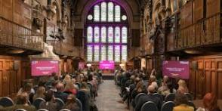
Engagement and Place
Academic Board
Over 2,000 young people have been supported through our Into University programme in the east end of Newcastle.
Funding secured through Research England Higher Education Museums and Galleries Fund with Tyne and Wear Archives & Museums to support work with external researchers and communities.
2024 Engagement and Place Awards and launch of the third People, Planet and Prosperity report

Slide 18

Engagement and Place
Academic Board
Some things to look forward to:
NU Discover – our first public engagement festival which will take place on 8 June https://www.ncl.ac.uk/discover-fest/
Insights North East annual conference – keynote Fiona Hill , 24 June.

Slide 19

Global
Academic Board
International student applications for 2024 entry holding up, but the sector is very challenged
We are focussing on international student growth across our three campuses.
Longer term, exploring several new TNE (Transnational Education) opportunities
ASEAN strategy being developed
Exploring/developing potential projects with Saudi Arabian universities including women's leadership in sport and sustainable “clean” energy
3rd highest in Russell Group for level of outward student mobility. Efforts to broaden access are working - over 70% of participants in 2023 summer programmes were from a WP background

Slide 20
Financial headlines

Slide 21
Current financial position - Financial results for 2023-24
Academic Board
  Student recruitment in September was relatively strong, particularly in comparison to the issues seen in many universities.
  However, our cost base continues to grow (albeit at a slower rate than last year).
  Costs forecast to exceed our total income this year – leading to an expected operating deficit of £8m this year.
  Need to be very mindful of our controlling our costs base where we can.
  Three-year financial plan being prepared.
 | 2023-24 | 2022-23 | Movement
 | Forecast | Actual | Plan
Operating Financial Results | £m | £m
Income | 629 | 608 | +3%
Expenditure | (637) | (604) | +5%
Operating (deficit)/surplus | (8) | 4
Key performance indicators
Staff Costs as % of total income | 58% | 57% | - 1pp
Cash balances | £206m | £218m | -6%
Staff numbers (FTE) – closing* | 6,200 | 6,033 | +3%
Notes:
Here is a quick overview of our latest financial position based on our latest forecast of how we expect the year to turn out
In comparison to the recruitment issues seen in some other universities, our recruitment in September was relatively strong
Whilst we didn’t fully deliver our student number plan, because we had been planning for growth we saw a good increase in international students on previous years
We are also seeing the benefit of higher interest rates generating more interest income on our cash reserves.
However, we are again being impacted by a continued growth in our cost base.
Part of this is the known increase in energy costs hitting us more this year as our energy hedging position reduced.
In simple terms we expect our total costs to exceed our total income this year and we forecast an operating surplus of around £8m.
This is still in line with our budget for the year, but is the first time the University is planning to run at a deficit budget.
We are currently compiling our next three-year financial plan and which needs to show a path back to positive surplus position.
We need all areas to be very mindful of controlling our costs whilst also identifying the opportunities where we can grow income in the future
Here is a quick overview of our finances for the year ending 31 July 2023
These results are subject to external audit and we expect to publish our accounts in mid-December.
We saw a good level of growth in our income last year, with total income growing by 9% to £608m.
This include growth across all our main income streams – tuition fee income, research income, funding body grants and other income.
Unfortunately, we also suffered a high level of growth in our cost base, which grew by 8% - driven by the accelerated pay award and high energy costs
The headline message is that we ended the year with a small positive operating surplus of £4m.
This was an improvement on our budget and the position we had been forecasting for most of last year.
Although a number of the factors leading to this were somewhat outside of our control – such as unexpected one-off funding awards received during the year.
Our staff base hasn’t grown as much as we had planned, ending the year relatively flat. This is over 200 roles below the position we expected to be in.
We still have a strong cash position despite continued capital investments like completion of the Stephenson Building phase 1.

Slide 22
Looking ahead

Slide 23


Looking ahead to the next few months
Academic Board
New Chair of Council, Pat Ritchie, from 1 August 2024
Appointment of a Deputy Vice-Chancellor
Overseas visits – forthcoming trip to Malaysia & Singapore
Alumni Refresher Weekend (12-14 July), including the annual meeting of Convocation
New members of Senate and Council being elected by academic and PS colleagues.

Slide 24
Questions

Slide 25
Thank you

Slide 26
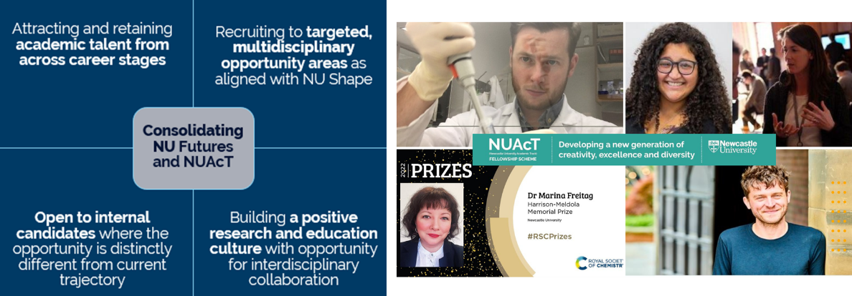
Research (1): NU Futures and NUAcT - Refreshed Recruitment Approach
Academic Board
Notes:
Approach and rationale:
We are consolidating NU Futures and NUAcT with the aim of recruiting candidates with outstanding academic potential and/or track records to shape the future of Newcastle University’s research, innovation and education excellence. This builds on the existing recruitment programmes for Newcastle University Academic Track (NUAcT) fellowships (at postdoctoral level) and NU Futures (for more established academics). We are amalgamating NU Futures and NUAcT in order to attract and retain academic talent from across career stages
Combining the two schemes will give us the flexibility to appoint outstanding candidates at whatever career stage is most appropriate, dependent on the pool of applicants and the identified needs of the University and host units.
We will be recruiting to targeting opportunity areas of strategic opportunity – this scheme represents one of the ways we are using the NU Shape process to invest in our strategy. These will be carefully identified in consultation with academic units and Faculties, drawing upon the NU Shape programme.
This aim will be to ensure the strategic development of the University’s research, innovation and teaching in the short, medium and long term. The scale at which we recruit can be dialled up or down depending on a range of factors, including the University’s developing financial position. We are aiming to recruit approx. 45 new NU Futures appointments over five years, beginning with 10 in 2024/25.
Planned recruitment of research leaders is one of the main levers we have at our disposal to affect the future direction of the University, to fulfil the commitments of our Education, Research & Innovation, Global, and Engagement strategies. NU Futures will use strategic funds to pump-prime investment in our people in the areas in which the University hopes to be leading across the next decade and more.
As previously conceived and instituted, NUAcT and NU Futures did not always support the specific strategic priorities of University or individual units.
This scheme ensures that we are competitive with our Russell Group counterparts, many of whom have cluster hire schemes of a similar nature, in a way that enables us to maximise the University’s limited budgets. Operational budgets will be under pressure during 24/25 and beyond, with opportunities to recruit future colleagues limited. However, there is a risk that if we pause efforts to build a pipeline of academic colleagues across grades, we will lose our competitive research power and fall behind in research intensivity. This will be detrimental to our performance in REF2029 and to our global reputation, as well as to our capacity to sustain our recent growth of research income. Even in the challenging financial circumstances affecting the whole sector, other universities, both inside and outside the Russell Group, have recently launched recruitment campaigns that will help to set them apart
The scheme will be open to internal candidates where the opportunity is distinctly different the candidate’s current trajectory.
Benefits:
Building a positive research and education culture: The refreshed scheme would retain our commitment to Equality, Diversity and Inclusion, as embedded in the NUAcT scheme, continuing to develop application processes that remain sector-leading in terms of EDI with the aim of recruiting a diverse cohort of existing and future leaders. By promoting the scheme to academics across career stages, we can build collaborative, collegial and interdisciplinary teams. Through recruiting at a cohort level in this way, and building on our existing commitments to research culture as embedded in the NUAcT scheme, we can achieve a more diverse community through delivering a supportive application process for colleagues with protected characteristics, and colleagues who have pursued non-standard career routes
Building on the success of NUAcT
Since its launch, the scheme will have recruited 70 fellows in a wide range of disciplinary areas through a range of open and targeted recruitment calls. We have a thriving community of fellows securing competitive funding, forging international collaborations and commercial partnerships, making significant policy impacts, leading Newcastle University Centres of Research Excellence, and enriching our collaborative, collegial and multidisciplinary research culture. Our fellows have: • secured >£22m in grant funding awards with a high success rate of applications (64%); • succeeded in some of the most competitive and high-profile funding schemes, including 13 external fellowships, 3 UKRI Future Leaders Fellowships and success in Horizon Europe; • achieved an impressive rate of progression through our University-wide promotion process: 15 promotions overall, including one to Professor, three to Reader, and 11 to Principal Research Associate; • been a crucial element in our wider endeavours to build a more equitable, inclusive and collaborative research culture.

Slide 27
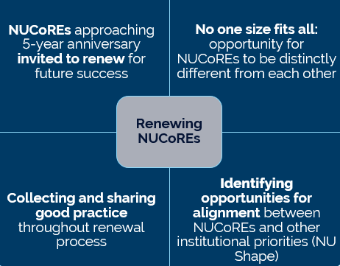





Research (2): NU Centres for Research Excellence (NUCoREs) Renewal
Academic Board
Notes:
Approach to renewal:
The first Newcastle University Centres of Research Excellence (NUCoREs) will have been operating for 5 years during the academic year of 23/24.
In recognition that the external research ecosystem, and internal groupings, structures and personnel, may have changed in that time, Centres approaching this 5-year milestone will be invited to renew and refresh for a further 5 years
The process is designed to be supportive and to enable the Centre to thrive in the future by being further attuned to internal and external opportunities.
The renewal process will provide an opportunity for the Centre to refresh its vision for future success, and provide a platform for the Centre to articulate what it needs to succeed.
Approach to renewal:
What are NUCoREs? They represent diverse teams of colleagues who are delivering important research missions, bringing colleagues together from across our three Faculties. We have 16 Centres.
The first Newcastle University Centres of Research Excellence (NUCoREs) will have been operating for 5 years during the academic year of 23/24.
In recognition that the external research ecosystem, and internal groupings, structures and personnel, may have changed in that time, Centres approaching this 5-year milestone will be invited to renew and refresh for a further 5 years
The process is designed to be supportive and to enable the Centre to thrive in the future by being further attuned to internal and external opportunities.
The renewal process provides an opportunity for the Centre to refresh its vision for future success, and provide a platform for the Centre to articulate what it needs to succeed.
This year, Heritage, Data, and Energy NUCoREs are all going through the renewal process which will conclude in the Summer
Whilst many Centres will want to retain many of these original characteristics, we want to give freedom for the Centres to conceptualise their own vision, determining for themselves what successful delivery of their vision looks like. There will not be a ‘one-size-fits-all’ model and the Centre will be best placed to judge how their success will be measured
The process will also further embed the Centres within the University’s evolving strategic planning. The NU Shape agenda provides an opportunity to align the Centres’ priorities with those of the wider University, and to enable us to better work together across structural boundaries which can be challenging to navigate.
Success and contributions
NUCoREs are making a significant contribution to our research culture here at Newcastle University – bringing colleagues together from across disciplines to respond to challenges, and supporting the development of colleagues at all career stages across the 16 different research areas.
Recent successes – this is by no means an exhaustive list of examples of the NUCoRE’s successes, but the logos here represent where NUCoREs recent contributions and successes. NUCoREs have enabled research funding success, such as via the £14m UK Rare Disease Platform, the recent renewal of the National Cyber Security Centre which gives the University exclusive access to research resources in this field of research. NUCoREs have also been integral to our University’s commitment to building external partnerships (with CORAM and the National Trust).
Alignment of successes and NUCoRE – the DARe hub – Mobility and Transport NUCoRE; UK Rare Disease Research Platform = Rare Disease NUCoRE; Children and Youth NUCoRE have established a strong partnership with the children's charity, Coram; the Heritage NUCoRE have established a strong partnership with the National Trust; the Cyber Security and Resilience NUCoRE has recently renewed its status as a GCHQ National Cyber Security Centre.

Slide 28

Town Halls 2024
Research (3): Research Culture Programme: Five Priority Projects
Behaviour Matters
Develop a preventative approach to tackling inappropriate behaviour and promote positive behaviours across the institution
Releasing Quality Time
Increase colleagues' abilities to create protected time for research activities
Building a positive research culture
Wellcome Institutional Fund for
Research Culture Project
£1m award to build enhanced leadership capacity to enable psychologically safe and inclusive research environments
Open Research
Develop and deliver an open research training programme to promote openness across the research cycle and make research more transparent
The Research Space
Develop an online portal that serves as a one-stop-shop to enable research career development, knowledge sharing and networking
Notes:
You will have hopefully seen messages about our Research Culture programme over the last couple of months. This communicated the top priority projects
4 top priority projects – here are some of the ways we are tackling these issues within the Research Culture space. We will be working in a joined up way across our Vision and Strategy to achieve our Research Culture objectives – particularly as we address releasing quality time, and behaviour too.
Our top priority projects are now underway – and the call for community involvement in these projects is still open.
There is a link here to further information about each project, should you wish to find out more.
More details on projects:
1. Releasing Quality Time -Offer research retreats
Create a vacation scholarship scheme for researchers
Consult with funders about a 'buy-out' scheme
Co-create an accessible online guide with resources
2. Behaviour Matters
UEB approval for the project and revised action plan
Project communication to the community by the VC
Develop and run facilitated workshop for VC and UEB members
Deliver 'Behaviour Matters' Action Plan
3. Open Research
Identify priority topics for institutional training
Agree strategy for recruiting trainers for UKRN train-the-trainer courses
Prepare trainer guidance
Support trainers in the delivery of open research training
4. The Research Space
Present a business case to the Technology Portfolio Board
Define the system scope to inform the procurement criteria
Procure system
Create general content to ensure relevant internal provision
5th priority project – Wellcome Trust Institutional Fund for RC project
£1M award from Wellcome’s Institutional Fund for Research Culture
Research project that will be co-produced with colleagues
Develop and deliver a 6-month leadership development programme
Create a positive environment for change through how we value and reward leadership
Use theory of change framework to evaluate impact
Key priorities of WT project:
Create knowledge to generate change
Work with leaders to change our approach to developing and recognizing leadership practices
Advocate for system wide culture change

Slide 29
Question:
Academic freedom is the lifeblood of the university in a democratic society. Recently it has come under unprecedented pressure from a variety of sources including pressure groups (both inside and outside universities), national government policies, university brand management agendas, and external funders (including illiberal governments). This is seen particularly over contentious issues like foreign wars and identity politics.
How are we as a university actively protecting academic freedom in this difficult context?
Academic Board

